Slide 1
Image compression

Slide 2
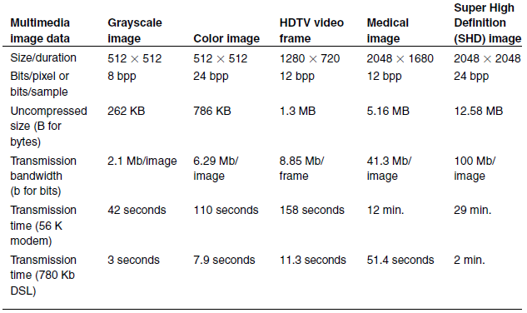
Size, Transmission Bandwidth and time for uncompressed images

Slide 3
Redundancy and relevance
Irrelevancy reduction, if information associated with some pixels might be irrelevant
Visual irrelevancy
Application-specific irrelevancy (medicine, military, ...)
Redundancy reduction, if pixel values are not random, but corelated
Lossy vs lossless compression
Spatial vs spectral vs temporal redundancy

Slide 4
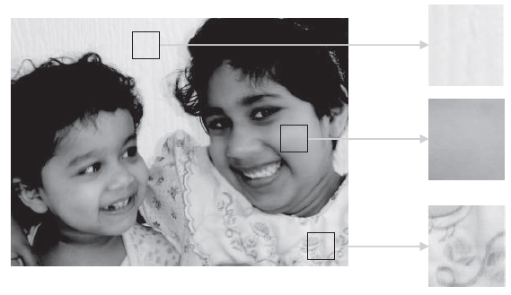
Local pixel correlation

Slide 5
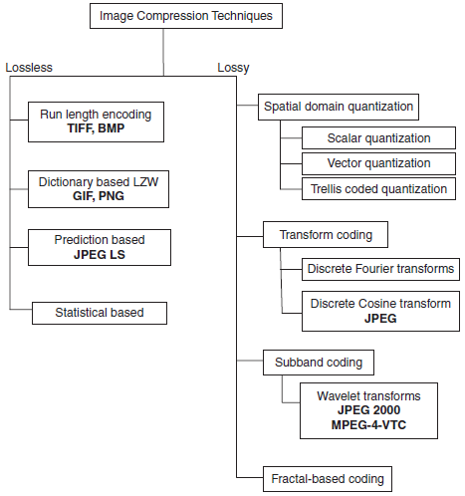
Classes of image compression techniques

Slide 6
Lossless image coding
A modest amount of compression can be achieved
First techniques develop for storage reasons
Limited use in practice today (in film industry)
BMP, TIFF, GIF, PICT
Run length coding (used very rarely, BMP, TIFF, PICT)

Slide 7
Dictionary based image coding
GIF and PNG standard
GIF was the first standard used for transfer on the Internet (developed by UNISYS Corporation)
A dictionary of indexes is build using LZW
Difference from pure LZW: indexes are not build on initial pixels, but on the indexed set of colors
Each pixel is represented by 8-bits value (form a palette of max 256 colors, where each color has its own index), and LZW is performed on the indexes of the palette

Slide 8
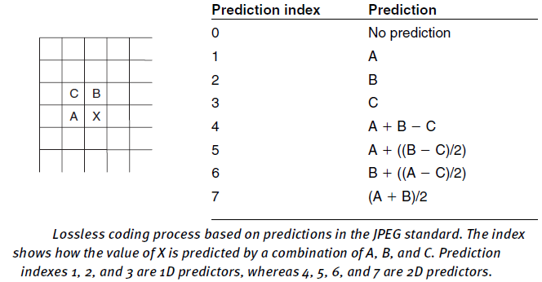
Prediction based coding

Slide 9
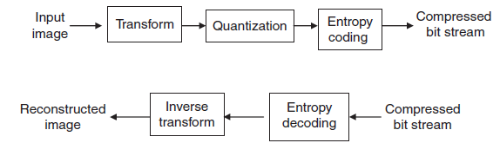
Transform image coding
The transform must be a mathematically invertible function
Examples: DFT, DCT

Slide 10
DCT Image coding and the JPEG standard
Why DCT was chosen by the JPEG community?
Good frequency domain energy distribution for natural images
Easy for efficient hardware-based computations

Slide 11
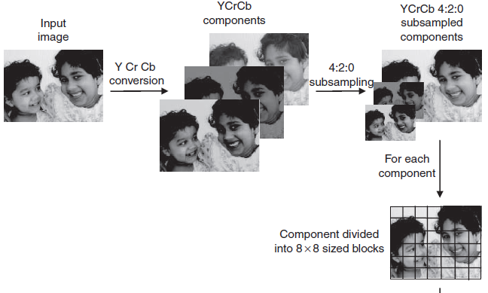
JPEG compression pipeline

Slide 12
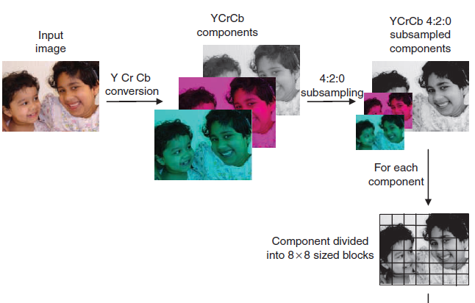
JPEG compression pipeline

Slide 13
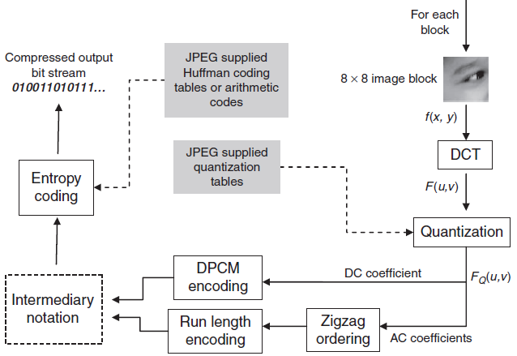
JPEG compression pipeline

Slide 14
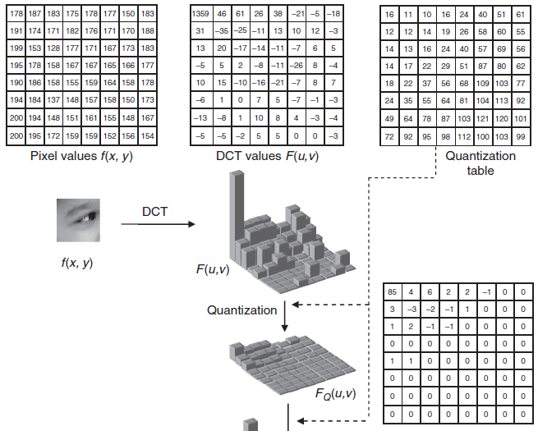
DCT example

Slide 15
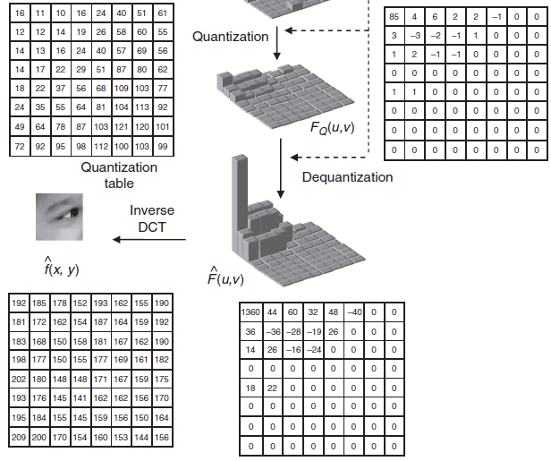
DCT example

Slide 16
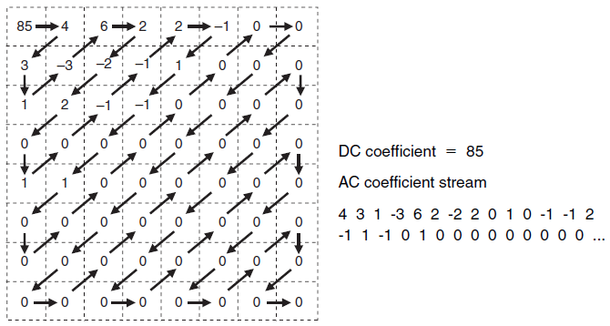
Zigzag ordering

Slide 17
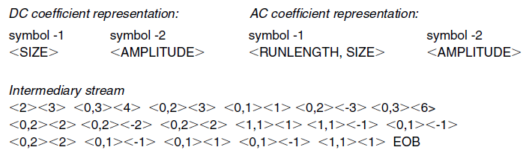
Intermediary representation
Runlength, number of consecutive AC nonzero elements
Size, number of bits used to encode the amplitude of DC and AC coefficients

Slide 18
Intermediary representation
Entropy coded using code supplies by JPEG organization
The first symbol in the intermediary representation is encoded using Hoffman coding which is variable length code (VLC), based on statistical analyzes of the elements
The amplitude is encoded using variable length integer code (VLI), that is shorter compared with Hoffman and not uniquely decodable
From VLC the decoder knows how to decode the VLI

Slide 19
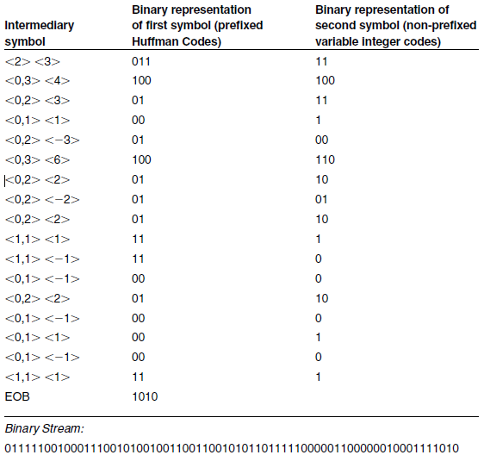
Coded representation of DC and AC coefficients

Slide 20
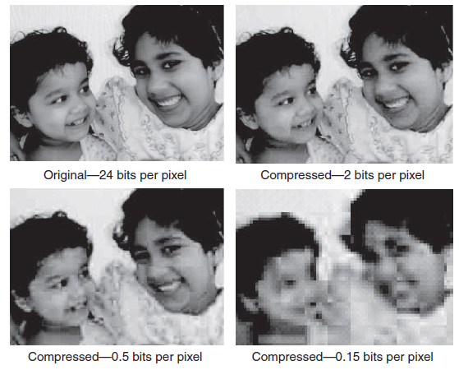
JPEG compression results

Slide 21
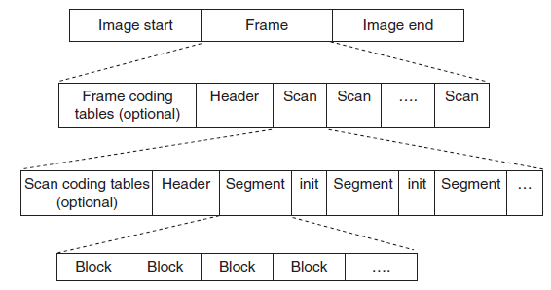
Hierarchical representation image=frame, segment=series of 8x8 blocks

Slide 22
Drawbacks of JPEG
Accepted since 1993 as a milestone
Poor low bit-rate compression
Random access of the bit stream
Single compression architecture (44 modes)
Transmission in noisy environments
Computer generated images and documents
Solution JPEG 2000 standard, based on a wavelet transform

Slide 23
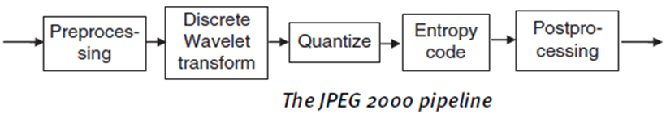
Wavelet transform (JPEG 2000)

Slide 24
Preprocessing step
Tiling process
YCrCb conversion process
The level offsetting process
All pixel values must be around zero, so the DWT can work properly

Slide 25
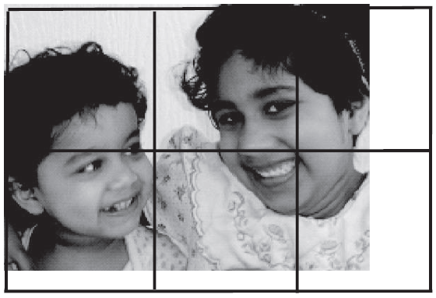
Wavelet transform (JPEG 2000) Preprocessing step

Slide 26
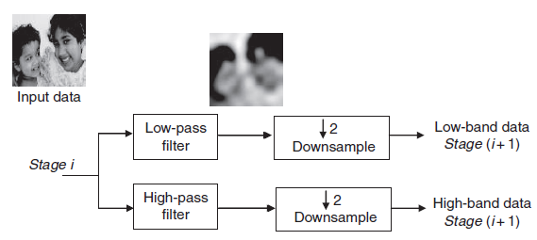
DWT (JPEG 2000)

Slide 27
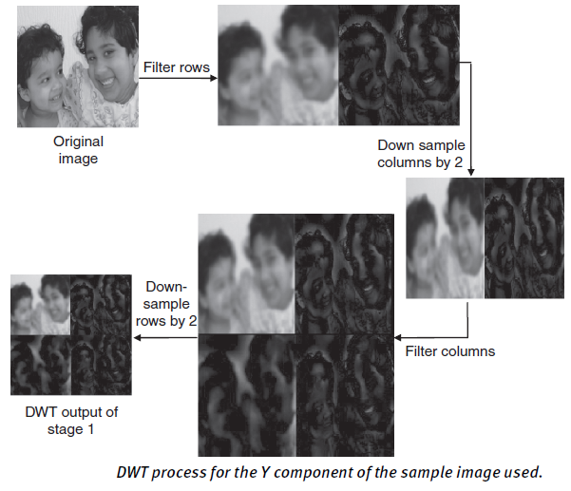
DWT (JPEG2000)

Slide 28
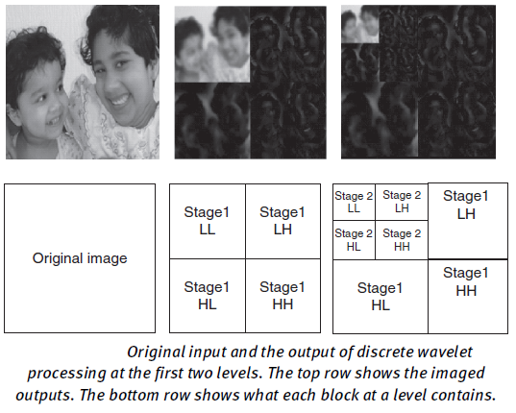
JPEG2000

Slide 29
JPEG vs JPEG2000
Encode once, platform dependent decoding (the encoder decides the maximum resolution and the image quality)
Working with compressed images (cropping, flipping, rotating can be applied to the compressed representation of the image)
Region of interest encoding

Slide 30
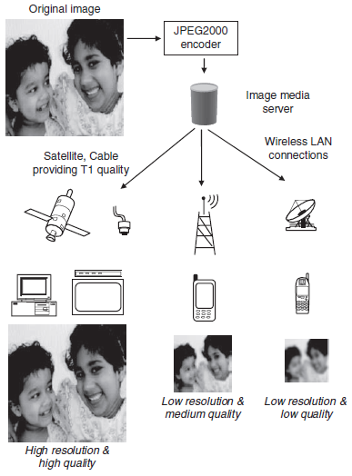
Encode once, platform dependent decoding

Slide 31
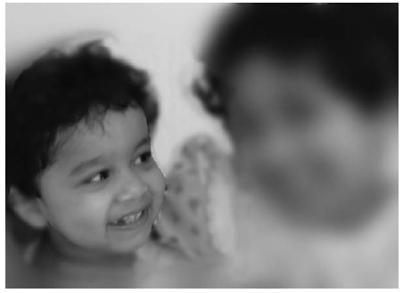
Region of interest encoding (ROI)

Slide 32
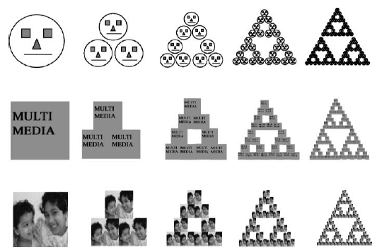
Fractal image coding

Slide 33
Fractal image coding
Fractals are self similar geometrical objects
Two important aspects:
Whatever initial seed image is used, the final resulting fractal structure is very similar
At every iteration, more detail is added

Slide 34
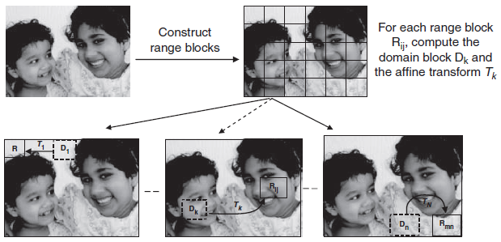
Fractal block coding

Slide 35
Transmission issues in compressed images
Transmission is still a challenging problem
Browsing image data
Sequentially organized image data needs to be completely downloaded before it can be decoded and viewed by a user
The experience is less interactive
The quality of the received data can be progressively improved over time

Slide 36
Progressive transmission in JPEG using DCT
Sequential scan (DC + zigzag AC coefficients)
JPEG has progressive modes where each block is encoded in multiple scans rather than a single scan
JPEG has two different methods for progressive transmission
Spectral selection (first DC, than AC)
Successive bit approximation (first MSB)

Slide 37
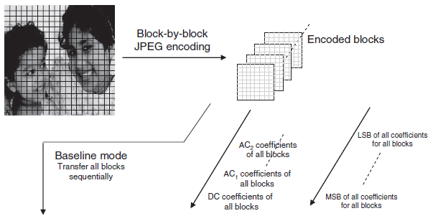
Progressive transmission in JPEG

Slide 38
